Slide 1
IROS Humanoid IKEA Assembly Challenge Evaluation - Participant Guide
Pittsburgh, PA
September 27th to October 1st

Slide 2
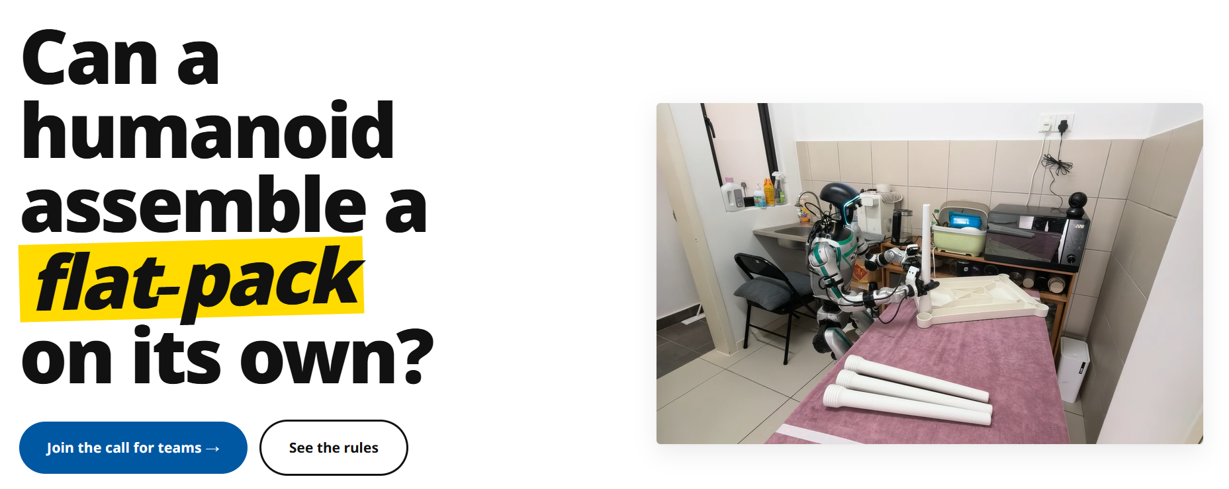

Slide 3
Resources
The Humanoid IKEA Assembly Challenge — IROS 2026
Unitree G1-U2 (with onboard Jetson Orin NX)
Unitree Dex1-1
2x Hand Cameras (Intel RealSense D405) with mounts
1x Head Stereo Camera (125 degrees FOV)
Jetson AGX Thor
Ethernet Cable
Desk Setup
IKEA Utter Table

Slide 4
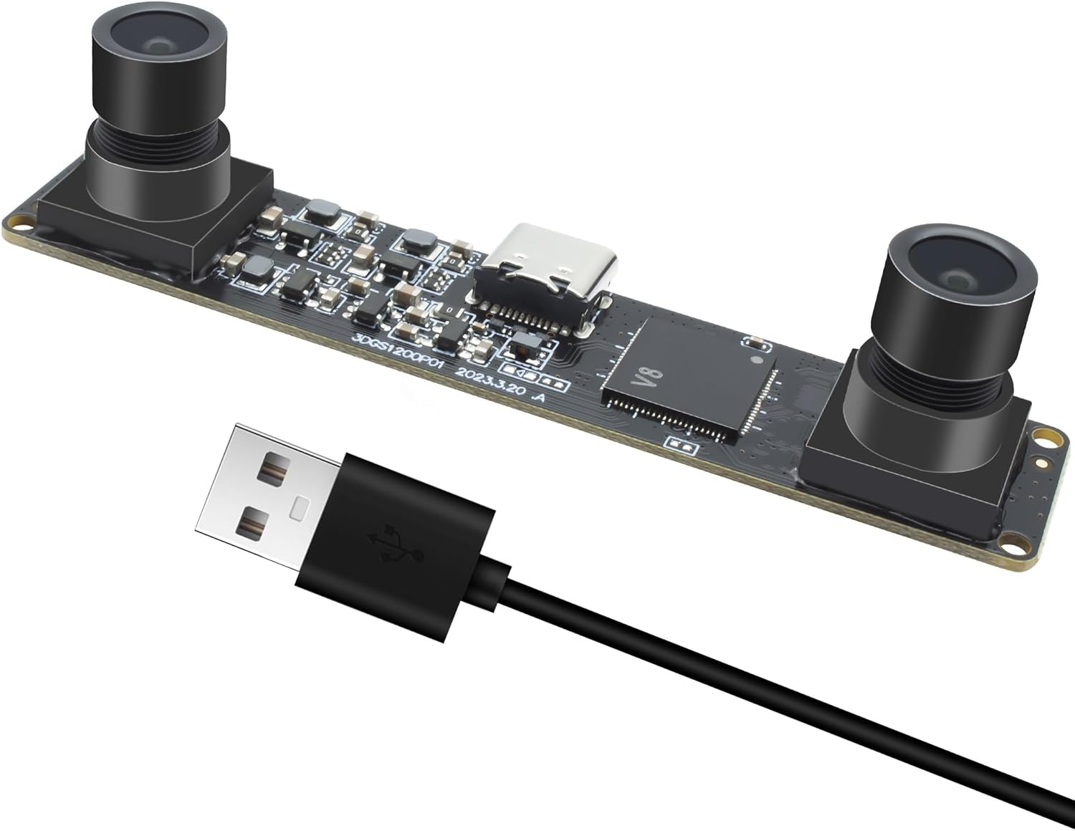
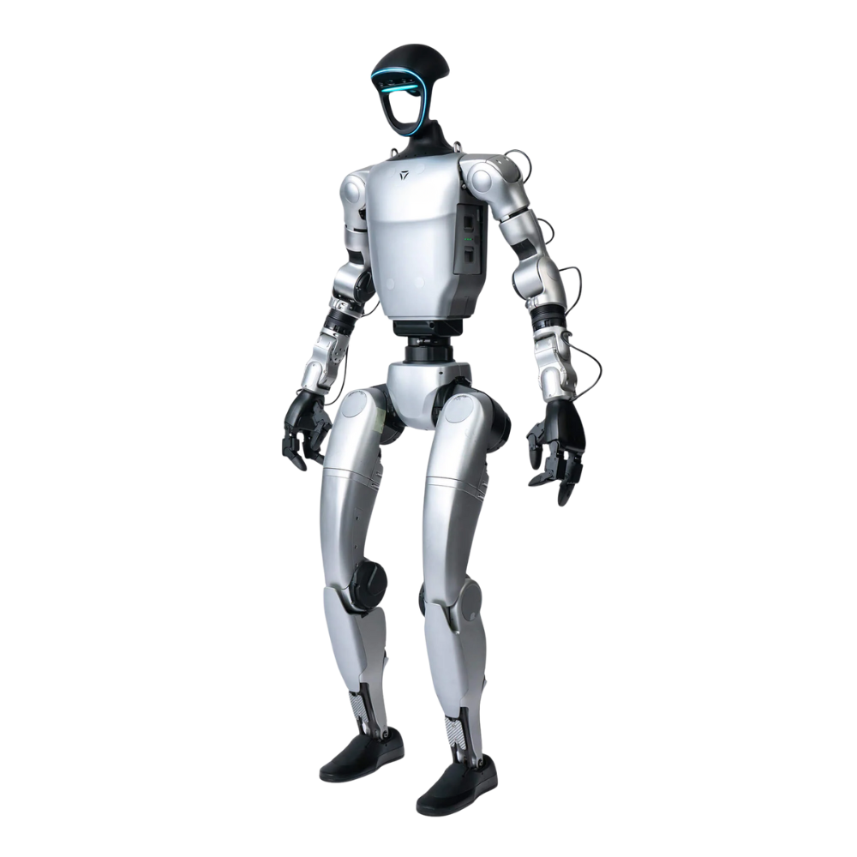
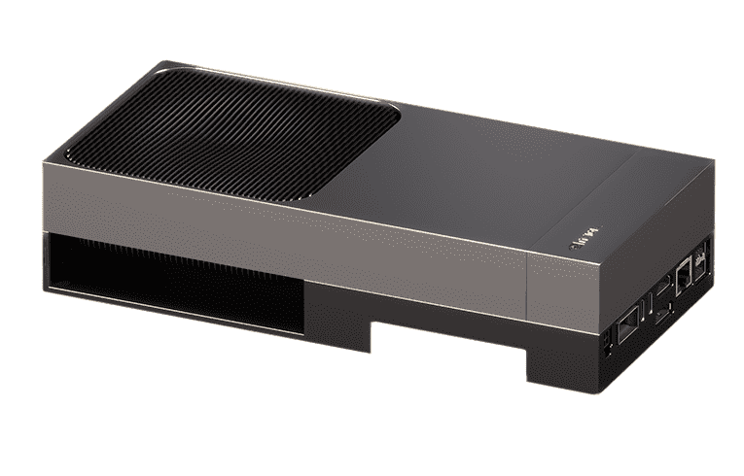
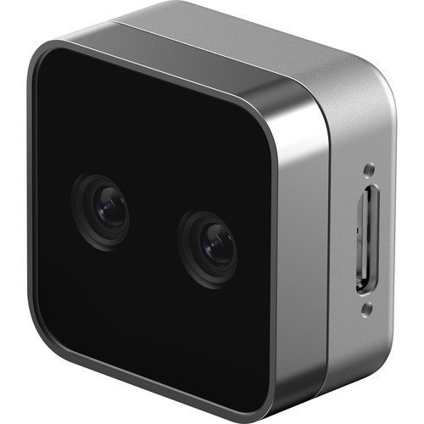
IROS IKEA Assembly Challenge
Unitree G1-U2 (with onboard NVIDIA Jetson Orin NX)
- Running policy client
NVIDIA Jetson Thor
- Running policy server
observations
actions

Slide 5
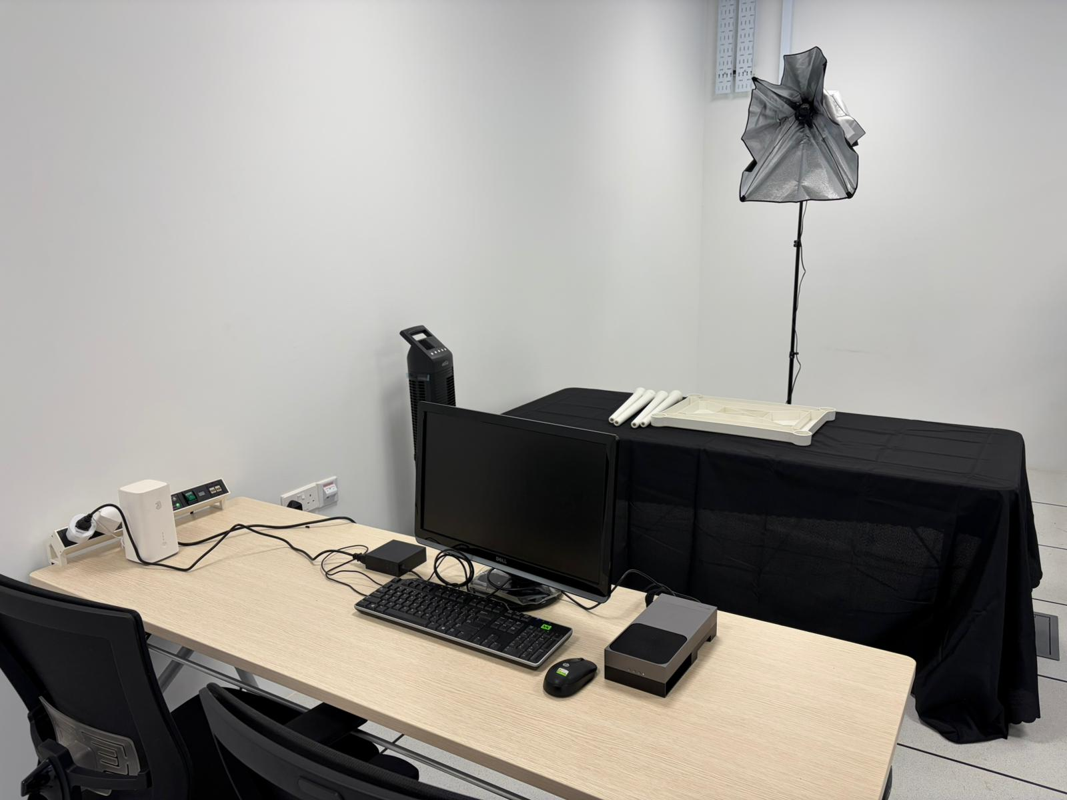
IROS IKEA Assembly Challenge
Notes:
Console | Brev

Slide 6
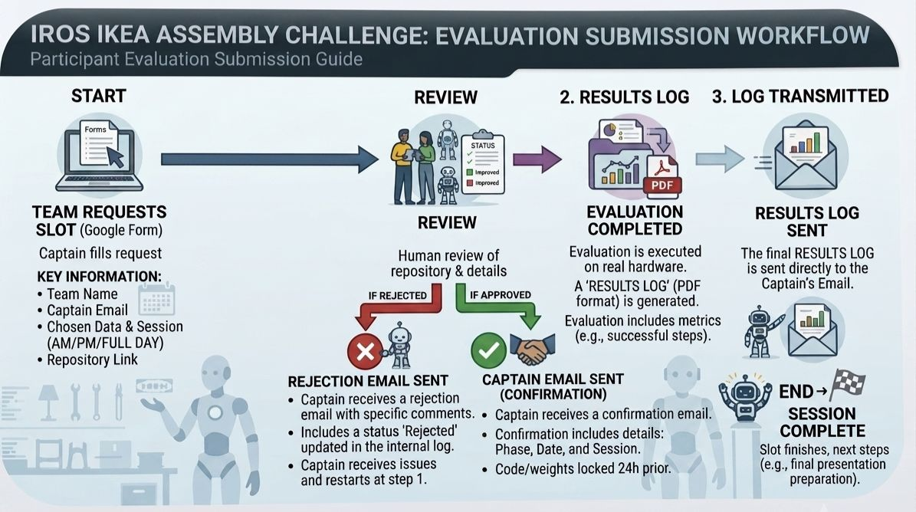
IROS IKEA Assembly Challenge

Slide 7
IROS IKEA Assembly Challenge - Submission Requirements
Send an email for Request to Submit to (iacevaltest@gmail.com) and include a zipped file/link with a video of policy working in simulation/real Unitree G1.
This Request to Submit email will need to be done one time only if approved.
Team captain is required to send a submission email titled:
- [IROS IKEA SUB] {Team Name}
Teams are to attach a zipped file/link within the email to a video of the policy working and validated in RoboFinals Simulation or real life.
If there is no video proof of assembly working in simulation/real Unitree G1, we will reject the request and require you to resubmit the request. This is to ensure safety for the evaluation team.

Slide 8
IROS IKEA Assembly Challenge - Submission Requirements
If request is approved, team will receive a link to:
- Google Forms = for booking request (https://docs.google.com/forms/d/e/1FAIpQLSf4O6Z3X4fb87p-cPM8qV6R8NzK6jVVfOJT51d2ecJZDLiO9A/viewform?usp=dialog)
- Google Calendar = for checking time slot availability (https://calendar.google.com/calendar/embed?src=21f1fcc71969d0fabba8e4728db4c2a5c74c1f258c63470259f2a0f255e31206%40group.calendar.google.com&ctz=Asia%2FSingapore)
From 6th August to 18th August, teams are only to submit their Policy Server and Client to ensure that it is compatible to run on the Jetson AGX Thor and Orin. Do refer to (https://github.com/iacevaltest/ikea_iros_submit)
Note that no real robot run will be done in the ONBOARDING period.
The ONBOARDING period will be used to ensure teams can get feedback on the Policy Server and Client execution and allow time to make any changes before committing to the policy submission.
Submission of DRY-RUN EVAL (policy weights, checkpoints, etc.) will be from 20th August onwards. This will be where the real robot run is done. Teams who still require further compatibility checking for ONBOARDING can continue as well.

Slide 9
IROS IKEA Assembly Challenge - Submission Requirements
1. Git repo URL — your code, containing the unmodified boundary/ and a Dockerfile for each container.
2. Thor image — policy server, pushed to a registry, referenced by digest (sha256:...). Base image MUST match the Thor's installed Jetson Linux: nvcr.io/nvidia/l4t-*:<TAG-TBD>. Target sm_110 (Blackwell).
3. Orin image — policy client, same, referenced by digest. Base image MUST match the Orin's installed Jetson Linux: nvcr.io/nvidia/l4t-*:<TAG-TBD>. Target sm_87 (Ampere).
NOTE: the two machines are on different JetPack lines and different GPU architectures. One image will not run on both. Build two.
4. Model weights — Hugging Face repo or upload link. NOT baked into the image. Include any access token or gating instructions.
5. Manifest (manifest.yaml in your repo) declaring:
- lane: sonic | decoupled
- both image digests
- base image tag used for each
- entrypoint command for each container
- your Thor<->Orin port
- weights URI
- peak GPU memory you expect on the Thor
6. Conformance output — terminal log of `python conformance.py --lane <lane>`passing against the current template.
7. Run command (INSTRUCTIONS.md) for each container, exactly as you expect us to invoke it, including any --runtime nvidia flags, mounts, or environment variables.

Slide 10
IROS IKEA Assembly Challenge - Submission Requirements
Team can only book a timeslot minimum 2 days in advance.
Booking of timeslot within the same day is not allowed.
10th to 14th August is blocked due to ongoing events..
There are 2 slots per weekday (Excluding Wednesday), pick AM (10am – 12pm Singapore time) or PM (2pm to 4pm Singapore time) session.
Maximum of 2 bookings per week (e.g. One AM session on Monday and One PM session on Thursday OR One FULL-DAY session on Tuesday = Max bookings per week) per team.
Teams get a maximum of 3 physical deployment attempts per 2-hour slot. If the failure is due to evaluation team hardware failure, the slot will be refunded and rescheduled.
Once time slot is booked, the booking will be pending and will be confirmed within one working day.
1st Priority will be given to teams who have not booked a session before or have the least number of bookings.
2nd Priority will be given to earliest team to book
Priority for DRY-RUN EVAL will be given to teams who declared to not have their own Unitree G1 robot.
If booking is unsuccessful for the specific timeslot, remaining team will be pushed to next available time slot.

Slide 11
IROS IKEA Assembly Challenge - Submission Requirements
Team captain will receive an email for the booking confirmation/rejection (if you don't see it in your inbox, please check your spam folder).
All code and model weights must be pushed to the designated repository at least 24 hours prior to your booked slot.
The Evaluation Team will run your submission at the allocated time slot and will provide feedback after.
Feedback will be given within 24 hours from the end of the time slot.

Slide 12
Onboarding
Blocked
Dry-Run Eval

Slide 13
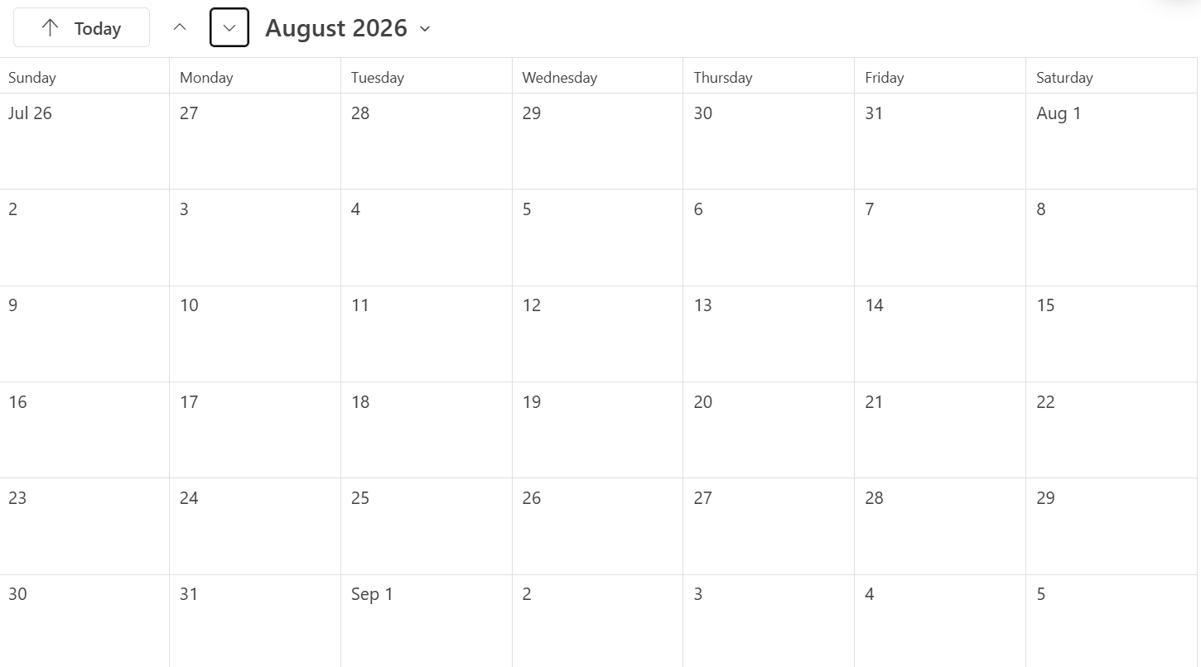

Slide 14
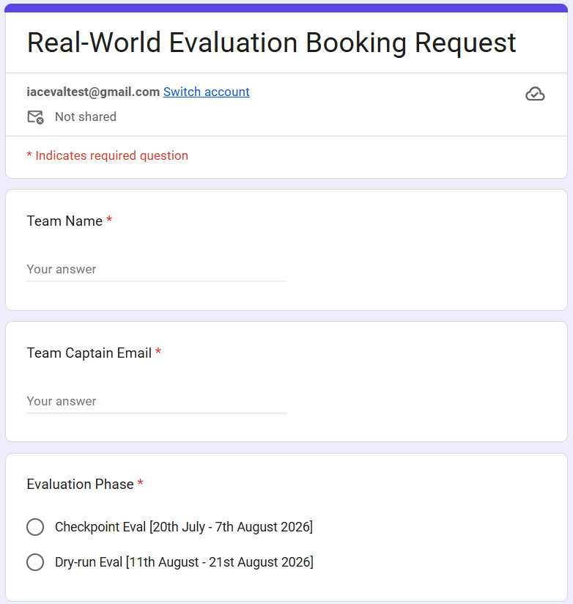
IROS IKEA Assembly Challenge

Slide 15
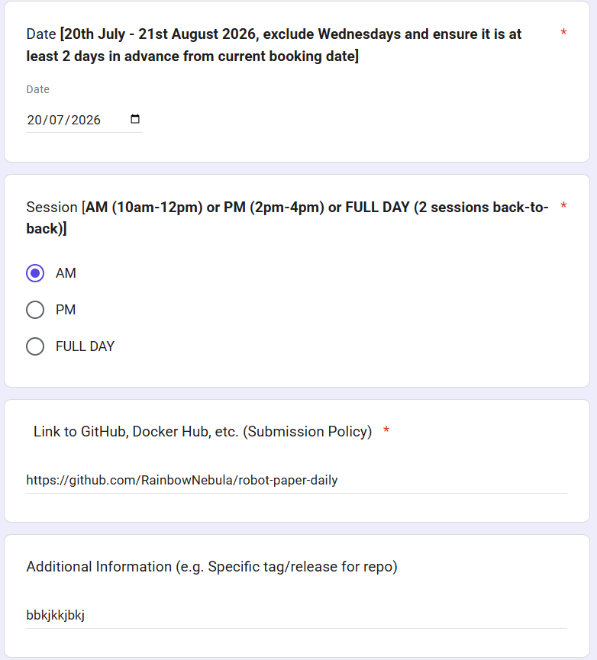
IROS IKEA Assembly Challenge

Slide 16
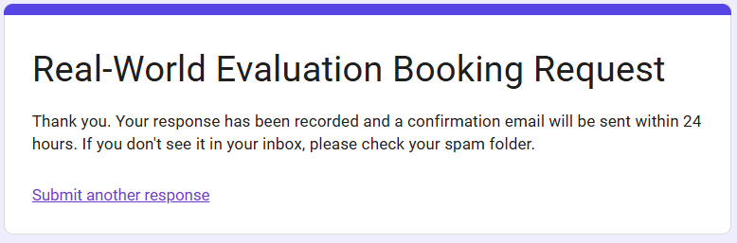
IROS IKEA Assembly Challenge

Slide 17
IROS IKEA Assembly Challenge
If there are any questions, do not hesitate to send an email to:
iacevaltest@gmail.com

